Slide 1

WEYLAND ENERGY
Presentation title in up to two lines
Subtitle · Event or audience · Date
Notes:
Layout 1 – Title with photo. Pick a calm photo from Photography/Examples; the Deep Sea overlay keeps the text readable.

Slide 2
Agenda
• Topic one
• Topic two
• Topic three
• Questions
WEYLAND ENERGY · Presentation template
2
Notes:
Layout 3 – Content. Up to six bullets, 18 pt. More than six? Split the slide.

Slide 3
Section title
Optional one-line description
Notes:
Layout 2 – Section divider in Teal.

Slide 4

Text and picture
• Three to five short bullets
• One idea per bullet
• Picture on the right half
WEYLAND ENERGY · Presentation template
4
Notes:
Layout 4 – Content with image.

Slide 5
Key figures
480 MW
1.2 Mt
97.4 %
450
Harrow Bay capacity
CO₂ avoided in 2025
Kestrel Ridge availability 2025
employees
WEYLAND ENERGY · Presentation template
5
Notes:
Layout 5 – KPI tiles. Use approved figures only – see Annual Report 2025.

Slide 6
Table layout
Project | Technology | Capacity | Phase
Harrow Bay | Offshore wind | 480 MW | Construction
Kestrel Ridge | Onshore wind | 75.6 MW | Operation
Millbrook | Solar & storage | 85 MWp + 40 MWh | Permitting
Fenwick | Battery storage | 100 MW / 200 MWh | Development
WEYLAND ENERGY · Presentation template
6
Notes:
Layout 6 – Table. Max. 8 rows.

Slide 7
“A quote that matters, in one or two lines.”
— Name, role
WEYLAND ENERGY · Presentation template
7

Slide 8
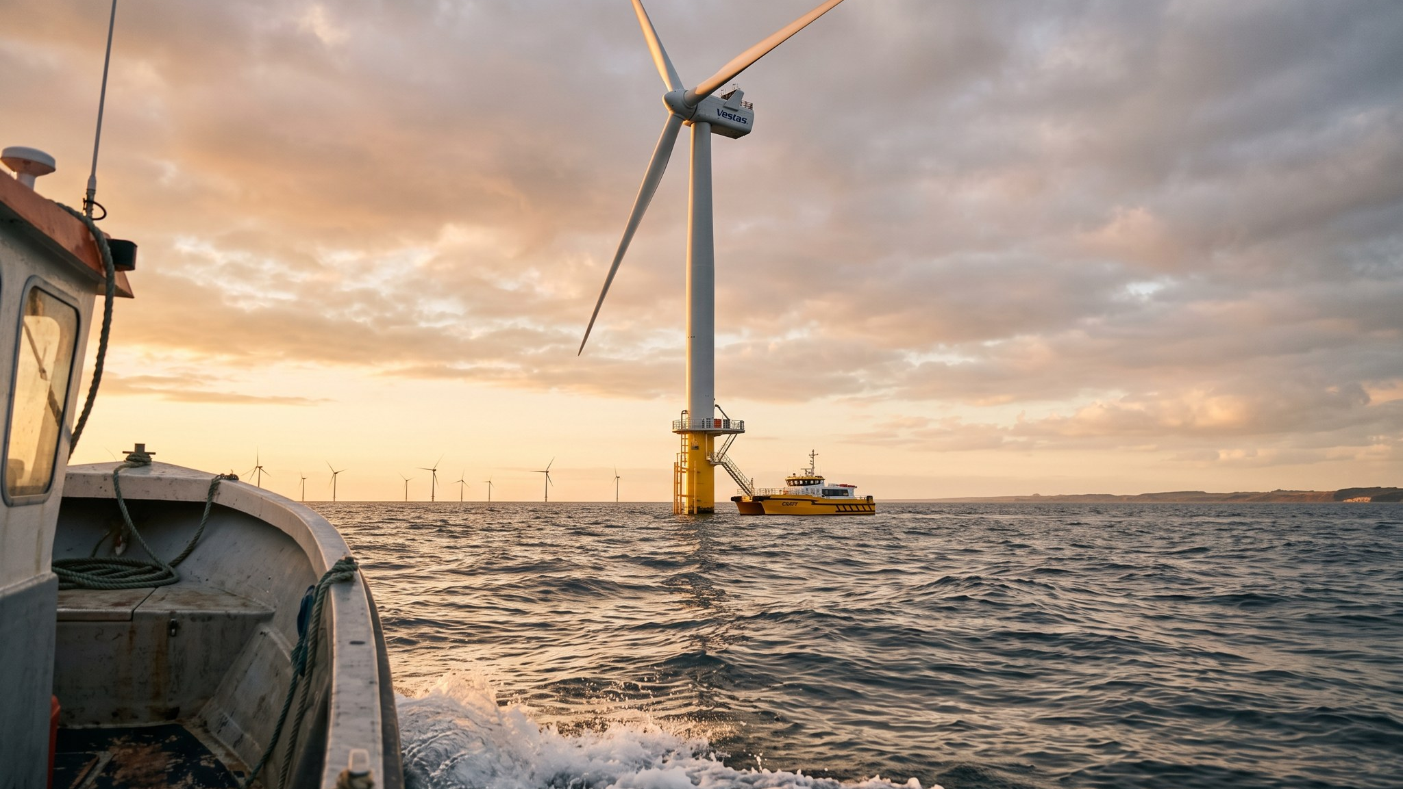
Full-bleed photo with caption
Caption: place, date
Notes:
Layout 8 – Full image.

Slide 9
WEYLAND ENERGY
Clean power, built to last.
Name · e-mail · weyland-energy.example

